Slide 1
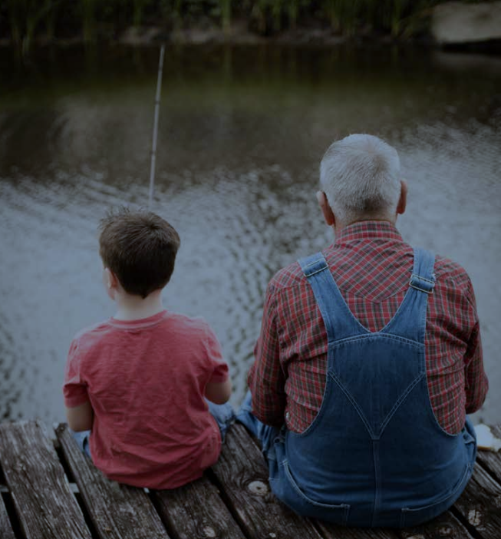
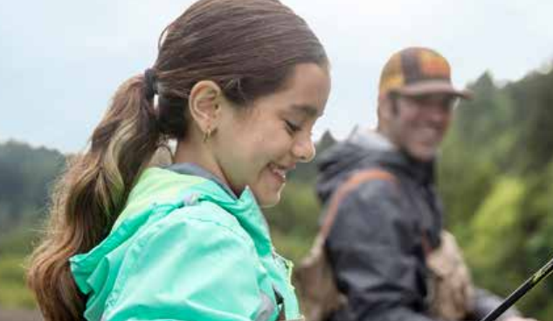
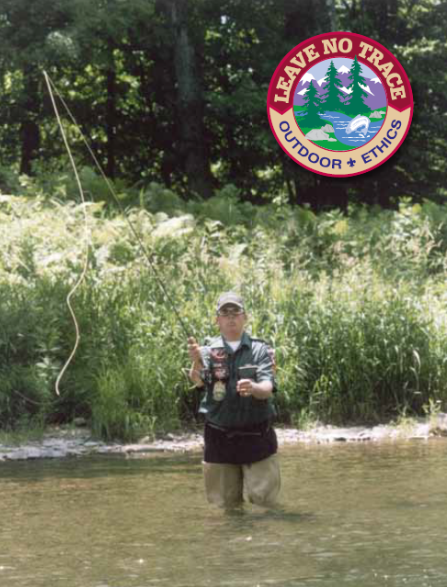
Fishing Ethics
Tips & Tools for Teaching Ethical Angling

Slide 2
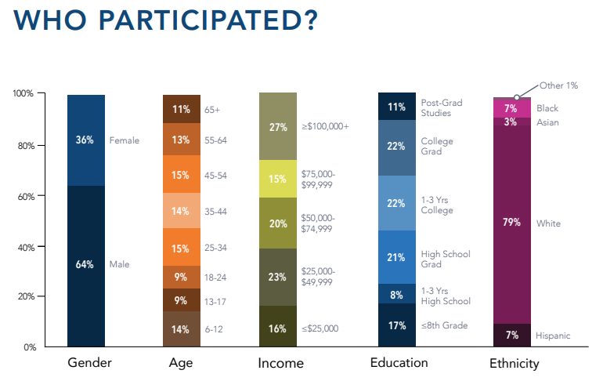
Why Fishing Ethics?
In 2019, 17% of the U.S. population ages 6 and up went fishing at least one time. This was a 1%-increase since the year before, and it represents a decade-long upward trend in fishing participation. Total 2019 participation was over 50.1 million participants nationwide.
Source: takemefishing.org

Slide 3
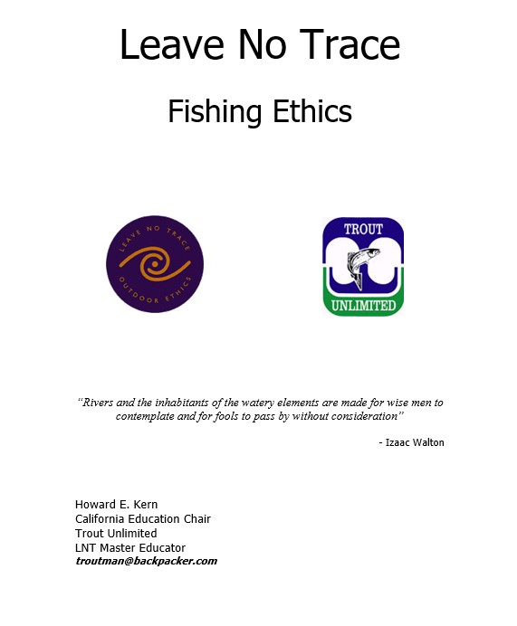
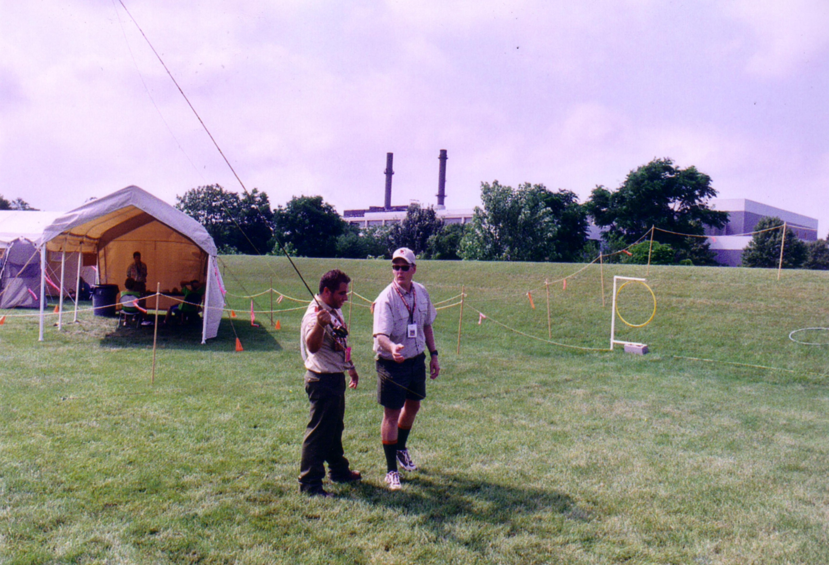
The Beginnings…
2000
2001
2002
2004
2006

Slide 4
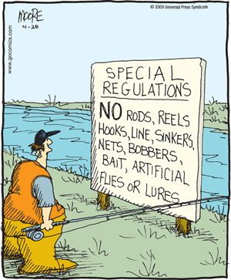
Plan Ahead and Prepare
Know the regulations and special concerns for the area you plan to fish. Some things to consider:
Do you have the right license? / Do you need a trout (special) stamp?
Do you understand the fish limits, length limits, boat registration requirements and life jacket rules?
Do you have the correct gear?
Is live bait allowed?
What about exotic species?
Prepare for extreme weather and emergencies.
Pack a large, strong, plastic litter bag (fish entrails).
Do you have a good map?

Slide 5
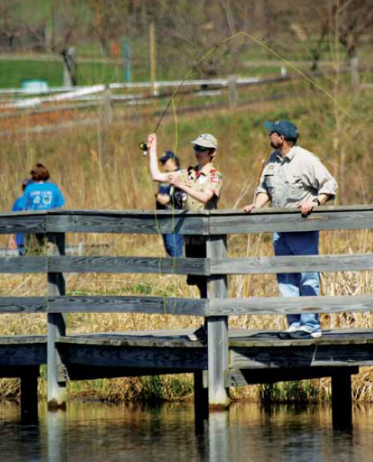
Travel and Camp on Durable Surfaces
Streams, rivers and lakes are very fragile ecosystems. The border between the water and dry land is called the “riparian zone” and it is an area that can be heavily impacted by foot traffic. These zones supply food, cover, and water for a diverse number of animals, both in and out of the water.
Access waters in designated areas or established entryways.
Use a boat or float tube if possible
If wading, travel on rock/gravel areas of the stream or river.
Docks and jetties are excellent areas to fish from.

Slide 6
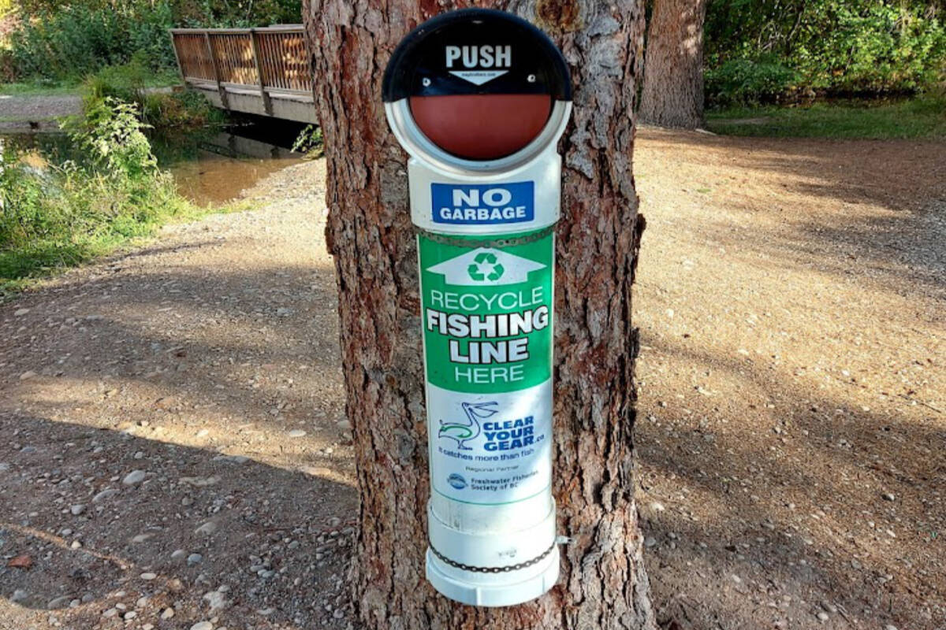
Dispose of Waste Properly
Fish Entrails - dispose of the entrails by burying them 200 feet away from water or pack them out in a strong garbage bag.
Anglers should make every attempt to retrieve snagged lures and broken lines which can be lethal. Monofilament fishing line should be placed in recycling containers if possible. Monofilament has an average shelf life of two to three years, while fluorocarbon lines can last up to seven or eight years.
Lead sinkers or jigs should be avoided completely.
Never dump unwanted live bait‚ or bait boxes. Pack it out.

Slide 7
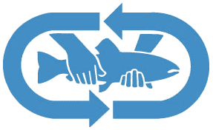
Leave What You Find
Catch And Release:
Do not “fight” a fish until it is utterly exhausted. Bring the fish quickly to hand or, preferably, a net (there are special ‘catch and release’ nets available).
Wet your hands before handling a fish to reduce damage to its protective coating. Grasp the fish firmly – but do not squeeze – across the back and head.
Use angler’s forceps, needle-nosed pliers, or other appropriate tools to remove the hook.
If the fish has taken the hook deeply or swallowed it, forcing the hook from the fish’s gills or stomach will do more damage than leaving it and will lower the chances the fish will survive. Instead, cut the leader or line and close to the hook as possible before releasing the fish.

Slide 8
Leave What You Find
Catch And Release cont.:
Keep the fish in the water as much as possible while handling it for release.
Before releasing the fish, place it in the water – head upstream – and move it back and forth gently for a few seconds to move water through its gills. This will rejuvenate the fish before release, giving it a better chance of survival. If you grip the fish lightly it will swim away, on its own, when it has revived.
Barbless hooks are the law in some situations. They lower mortality rates among released fish by as much as 25%. Consider using barbless – or pinching the barb down with pliers – even where it isn’t the law.
Even catch and release can be overdone. If you have caught enough – and you’ll know when that is – consider leaving the rest of the fish in peace and simply sitting and watching the water and enjoying the backcountry.

Slide 9
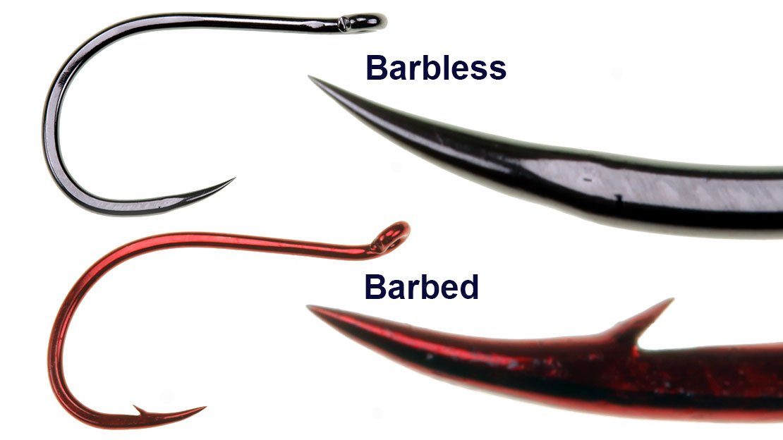
Leave What You Find

Slide 10
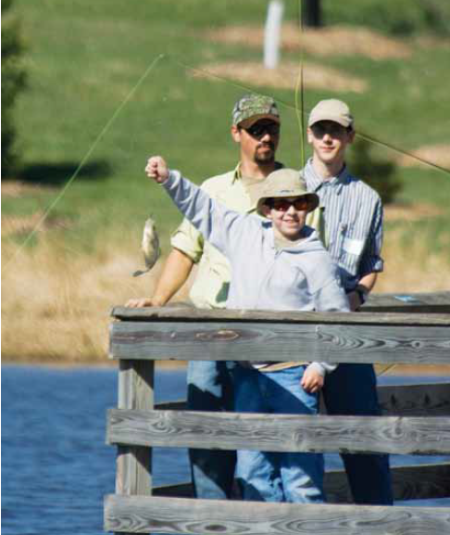
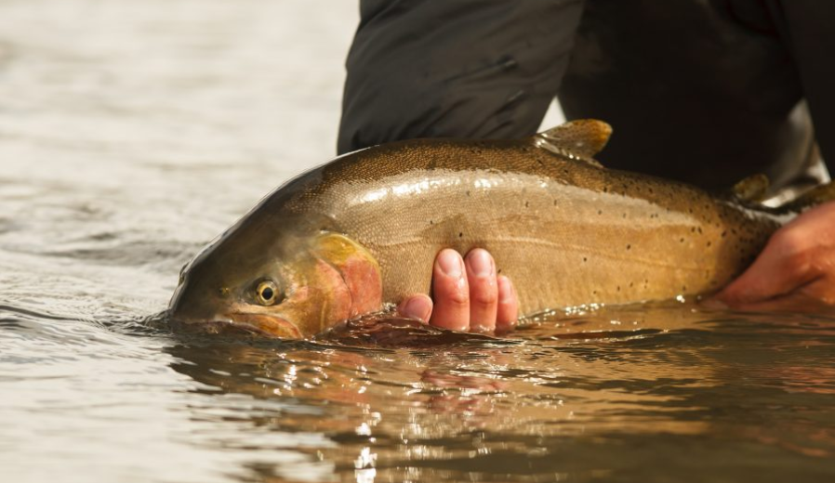
Leave What You Find

Slide 11
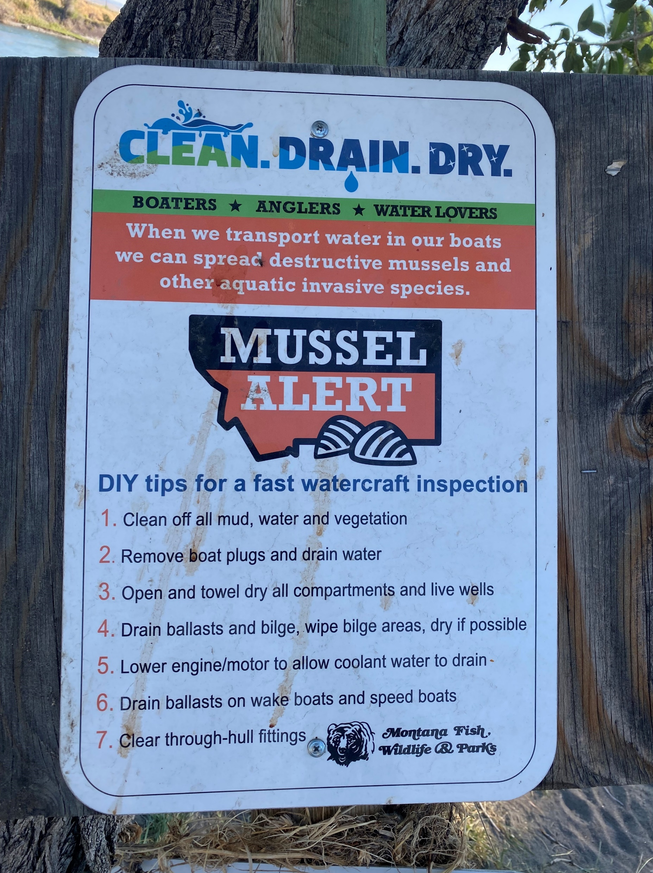
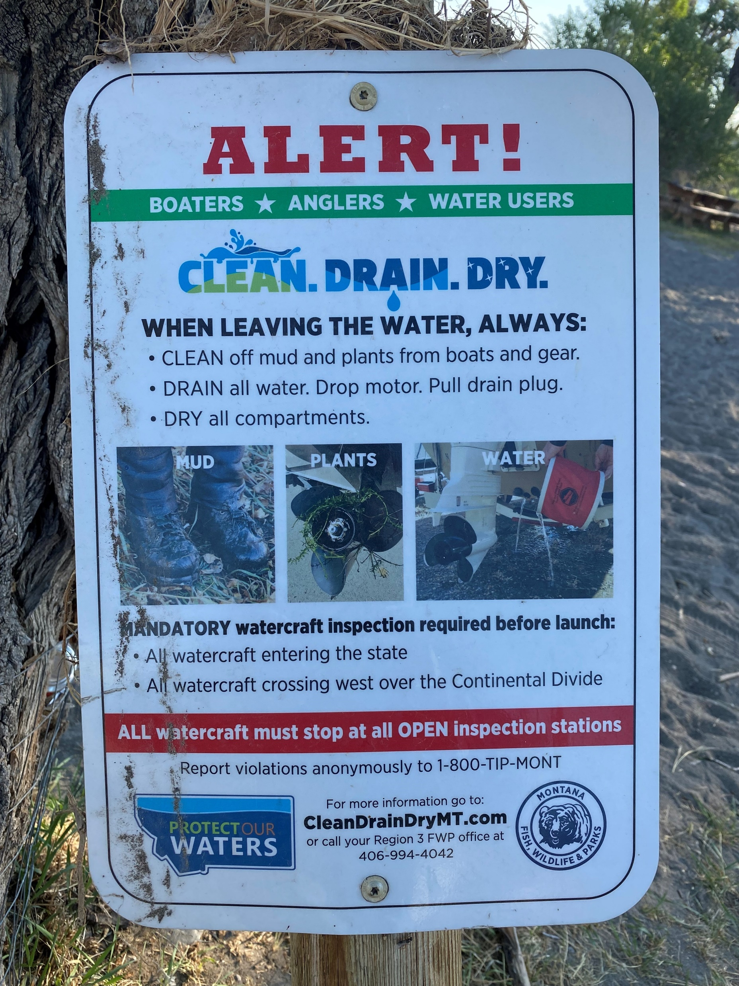
Leave What You Find
Invasives: Be sure to always clean your boat, gear and clothing after a fishing trip so you don't spread invasive species that might have caught a ride home. Waders and boots should use a 50% solution (1 part chlorine to 1 part water) - dip waders into a solution of the bleach or wipe or spray it on. Use a 10% solution (1 part chlorine to 9 parts water) and soak your equipment for 10 minutes.

Slide 12
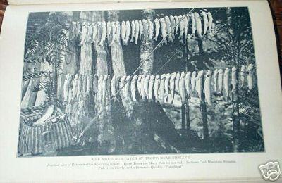
Leave What You Find
“Limit your kill; don’t kill your limit”

Slide 13
Respect Wildlife
Humane killing of fish If you respect wildlife, then how it is treated becomes a matter of concern. If you plan on keeping a fish you caught, then dispatch it right away. Don’t let it sit on a stringer while you continue to fish. The quickest and most humane way is to sever the spinal column behind the head of the fish. This can be accomplished by using a knife, or a sharp blow with a blunt object. Clean and ice down your catch as soon as possible.
Don’t kill fish you find undesirable Other species, even if non-game fish, are part of an entire ecosystem. What you do to one species causes ripple effects to the entire ecosystem of the area.
Treat the resource and others with respect. It is a privilege to be outdoors.

Slide 14
Be Considerate of Other Visitors
Travel in small groups no larger than that prescribed by the land managers.
Let nature’s sounds prevail. (fish can be easily spooked).
Select fishing spots and campsites away from other groups to help preserve their solitude (and your chances of catching fish). The ethical angler will do this even if it means walking a bit further down the stream or lakeside.
Always travel quietly to avoid disturbing other visitors.
Make sure the colors of your clothing and gear blend with the environment.
Respect private property and leave gates (open or closed) as found.

Slide 15
Discussion of Fishing in Trainers / Masters Courses
“ Many men go fishing all of their lives without knowing that it is not fish they are after. “
Henry David Thoreau

Slide 16
Certified Angling Instructor Course
The CAI course syllabus includes age-appropriate skills using fishing tools and techniques for their Scouts, ranging from Cane Pole to Fly Fishing.
The course will highlight best practices on content delivery, in both the classroom and the field.
Provide a positive fishing experience & improve your council’s fishing program.
Fishing is 4th among Scout Interests! Why not use that to increase the FUN FACTOR!
Participants will become confident in fly tying, fly casting, knot tying, and catch and release practices.
CAI offers quality fishing gear at value pricing/cost effective purchase power for units and Councils alike.
CAI Course offered prior to the 2022 BSA National Outdoor Ethics and Conservation Conference November 9th and 10th
Michael R. Brand
B.S.A. Certified Angling Instructor
CELL: 314.477.8120 Email: michaelbrand314@gmail.com

Slide 17
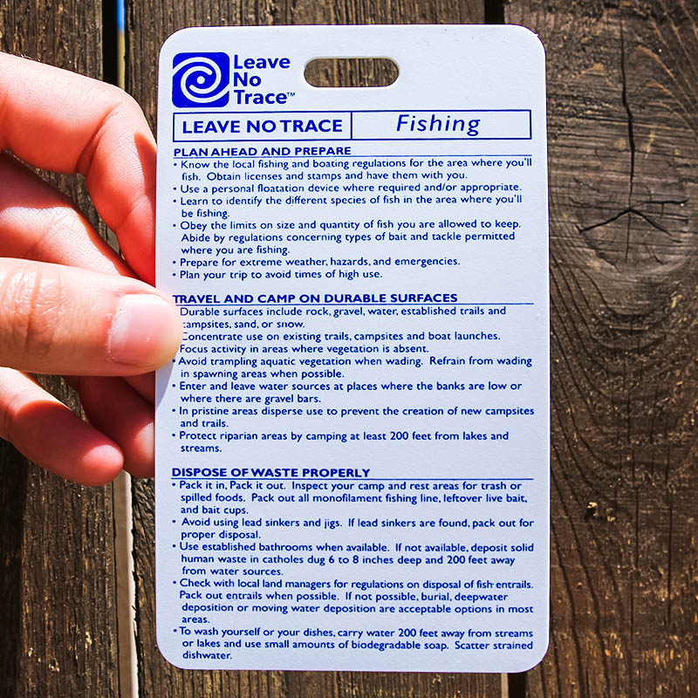
Resources for Training
BSA Fishing Partners
International Game Fish Association - https://igfa.org/
Aquatic Resources Education Association - https://www.areanet.org/
Take Me Fishing - https://www.takemefishing.org/
Trout Unlimited - https://tu.org/
Federation of Fly Fishers - http://www.fedflyfishers.org/
Fishing / Fly Fishing Merit Badge Pamphlets
Fishing Leave No Trace Pamphlet / Hang Tag

Slide 18
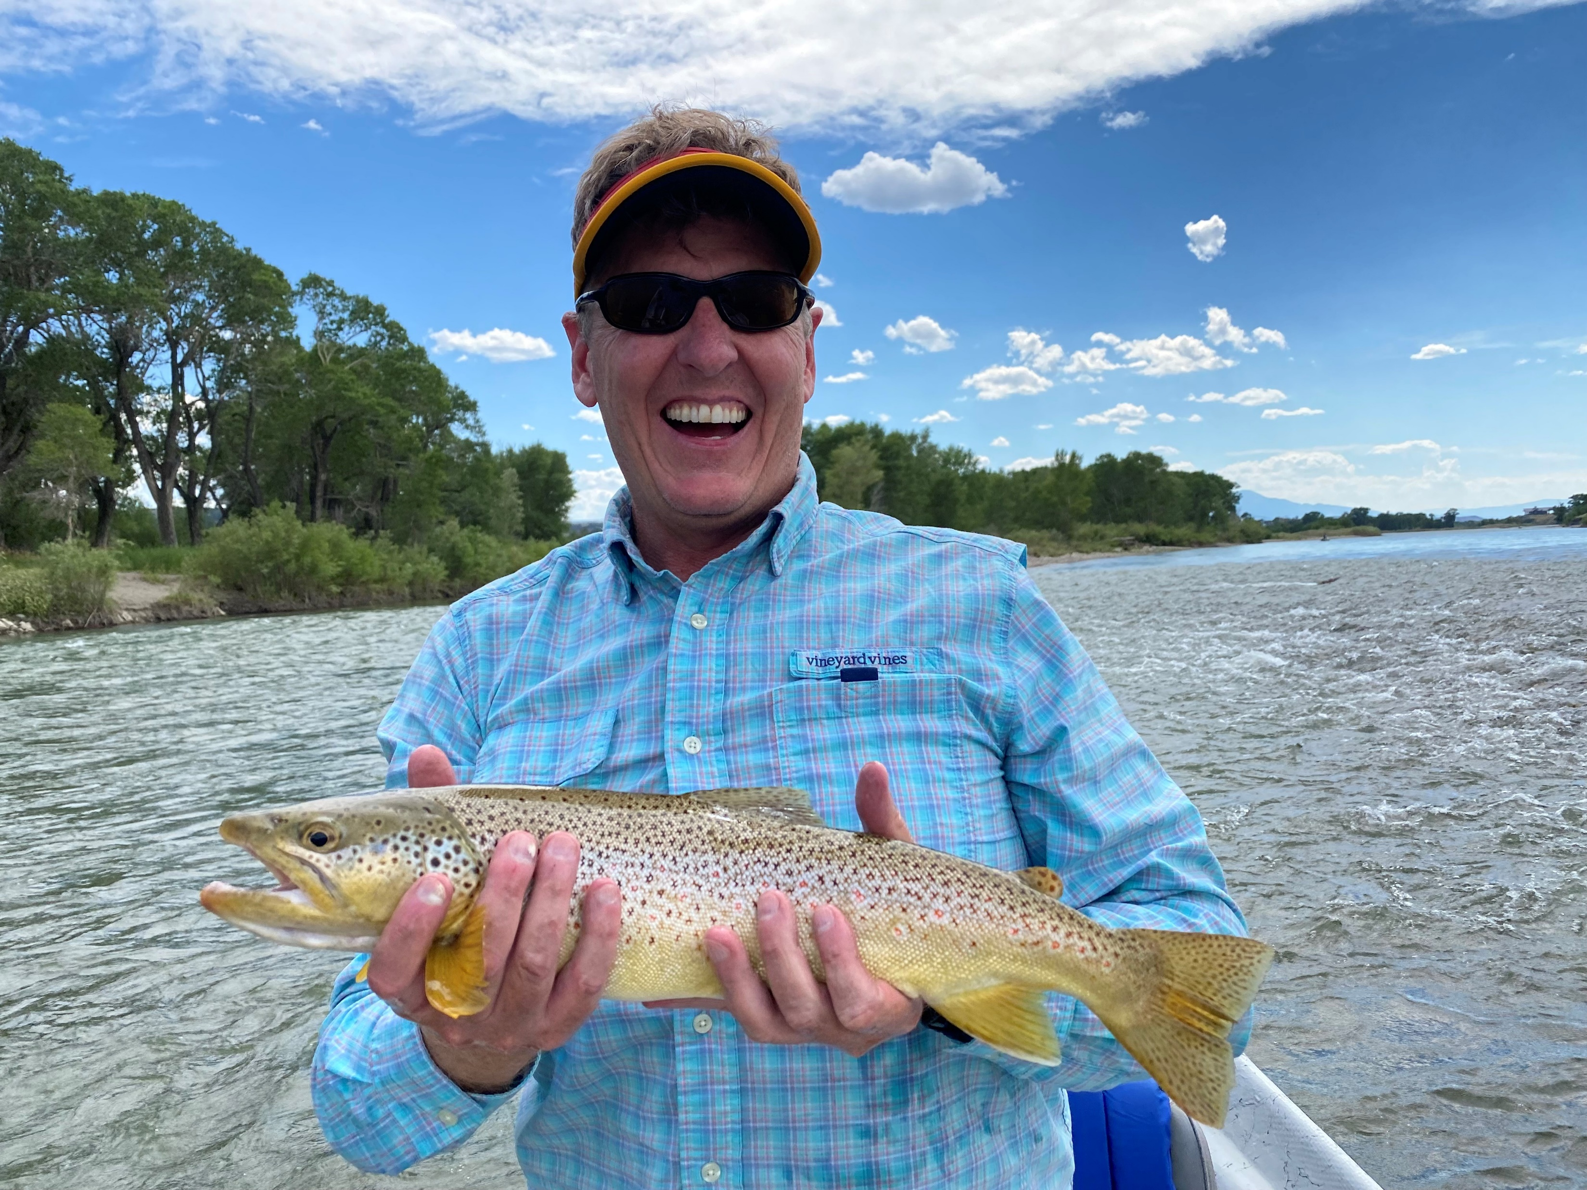
Questions / Comments
Howard Kern
CELL: 805-405-9635
Email: Venturing4Trout@roadrunner.com

